Slide 1
Project Management Process Groups
SE423: Software Project Management

Slide 2
Outline
Introduction
Initiating processes
Planning processes
Execution processes
Controlling and Monitoring processes
Closing processes
Agile and Scrum

Slide 3
Introduction

Slide 4
Learning Objectives
Describe the five project management process groups, the typical level of activity for each, and the interactions among them
Relate the project management process groups to the project management knowledge areas
Discuss how organizations develop information technology (IT) project management methodologies to meet their needs
Review a case study of an organization applying the project management process groups to manage an IT project, describe outputs of each process group, and understand the contribution that effective initiating, planning, executing, monitoring and controlling, and closing make to project success

Slide 5
Learning Objectives
Review a case study of the same project managed with an agile focus and compare the key differences between an agile approach and a predictive approach
Describe several templates for creating documents for each process group

Slide 6
Introduction
Project management consists of 10 knowledge areas
Integration, scope, schedule, cost, quality, resource, communications, risk, procurement, and stakeholder management
Projects involve five project management process groups
Initiating, planning, executing, monitoring and controlling, and closing
Tailoring these process groups to meet individual project needs increases the chance of success in managing projects

Slide 7
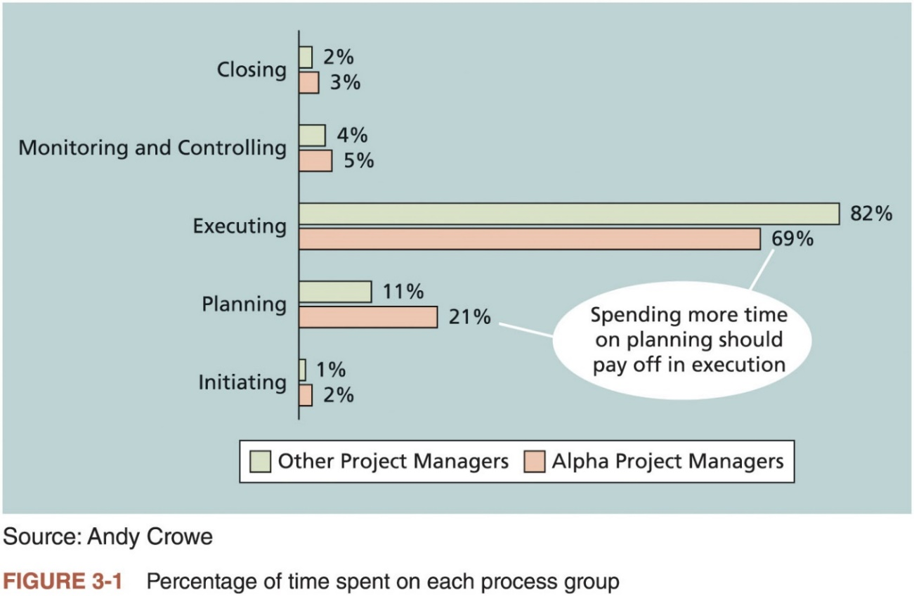
Project Management Process Groups
A process is a series of actions directed toward a particular result
Project management can be viewed as a number of related processes
Project management process groups
Initiating processes
Planning processes
Executing processes
Monitoring and controlling processes
Closing processes

Slide 8
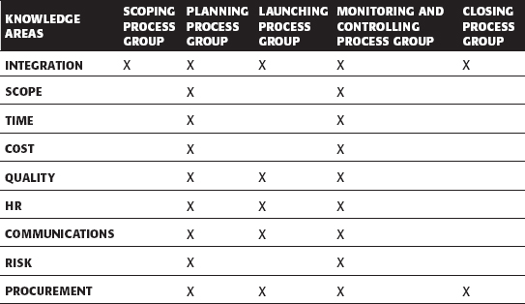
Mapping the Process Groups to the Knowledge Areas
You can map the main activities of each PM process group into the ten knowledge areas
Note that there are activities from each knowledge area under the planning process groups

Slide 9
Developing an IT Project Management Methodology
Many organizations develop their own internal IT project management methodologies
A methodology describes how things should be done
A standard describes what should be done
Different project management methodologies
PRojects IN Controlled Environments (PRINCE2)
Agile
Rational Unified Process (RUP)
Six Sigma
DevOps

Slide 10
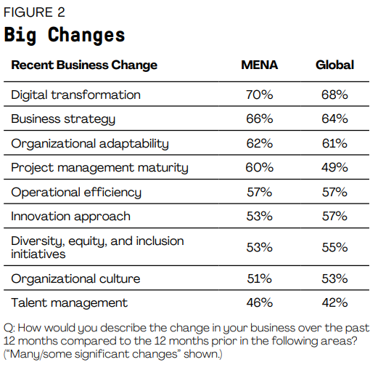
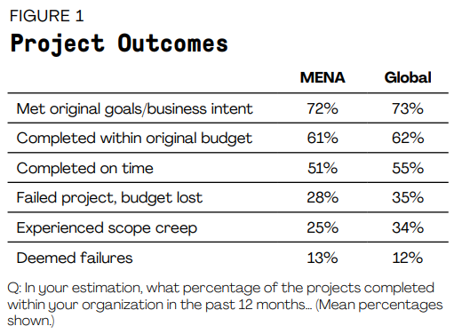
Global Issues
PMI published (Pulse of the Profession®2021) for Middle East & North Africa (MENA)

Slide 11
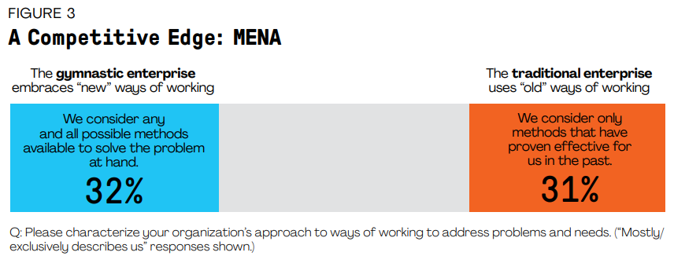
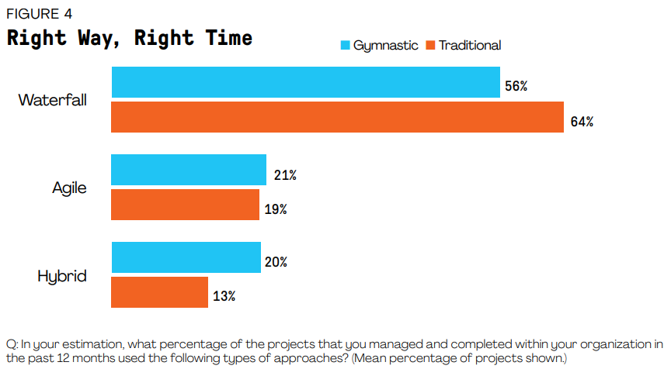
Global Issues
PMI published (Pulse of the Profession®2021) for Middle East & North Africa (MENA)

Slide 12
What Went Right?
Organizations that excel in project management complete 89 percent of their projects successfully compared to only 36 percent of organizations that do not have good project management processes
PMI estimates that poor project performance costs over $109 million for every $1 billion invested in projects and programs

Slide 13
Case Study: JWD Consulting’s Project Management Intranet Site (Predictive Approach)
This case study provides an example of what’s involved in initiating, planning, executing, controlling, and closing an IT project
You can download templates for creating your own project management documents from the companion website for this text or the author’s site
Note: this case study provides a big picture view of managing a project
Later chapters provide detailed information on each knowledge area

Slide 14
Initiating processes

Slide 15
Project Pre-Initiation and Initiation
Initiating includes recognizing and starting a new project
Right kinds of projects for the right reasons
Strategic planning should serve as the foundation for deciding which projects to pursue
Expresses the vision, mission, goals, objectives, and strategies of the organization
Provides the basis for IT project planning

Slide 16
Pre-initiation Tasks
It is good practice to lay the groundwork for a project before it officially starts
Senior managers often perform several pre-initiation tasks
Determine the scope, time, and cost constraints for the project
Identify the project sponsor
Select the project manager
Develop a business case for a project
Meet with the project manager to review the process and expectations for managing the project
Determine if the project should be divided into two or more smaller projects

Slide 17
Initiating (1 of 5)
Project initiation knowledge areas, processes, and outputs
Knowledge Area | Initiating Process | Initiating Process
Project Integration Management | Develop project charter | Project charter Assumption log
Project Stakeholder Management | Identify stakeholders | Stakeholder register Change requests Project management plan updates Project documents updates

Slide 18
Initiating (2 of 5)
Stakeholder Register
Name | Position | Internal/External | Project Role | Contact Information
Joe Fleming | CEO | Internal | Sponsor | joe_fleming@jwdconsulting.com
Erica Bell | PMO Director | Internal | Project Manager | erica_bell@jwdconsulting.com
Michael Chen | Senior Consultant | Internal | Team Member | michael_chen@jwdconsulting.com
Kim Phuong | Business Analyst | External | Advisor | kim_phuong@client1.com
Louise Mills | PR Director | Internal | Advisor | louise_mills@jwdconsulting.com

Slide 19
Initiating (3 of 5)
Stakeholder Management Strategy
Name | Level of Interest | Level of Influence | Potential Management Strategies
Joe Fleming | High | High | Joe likes to stay on top of key projects and make money. Have a lot of short, face-to-face meetings and focus on achieving the financial benefits of the project.
Louise Mills | Low | High | Louise has a lot of things on her plate, and she does not seem excited about this project. She may be looking at other job opportunities. Show her how this project will help the company and her resume.

Slide 20
Initiating (4 of 5)
Drafting the project charter
See Table 3-6 for an example
Holding a project kick-off meeting
It’s good practice to hold a kick-off meeting at the beginning of a project so that stakeholders can meet each other, review the goals of the project, and discuss future plans

Slide 21
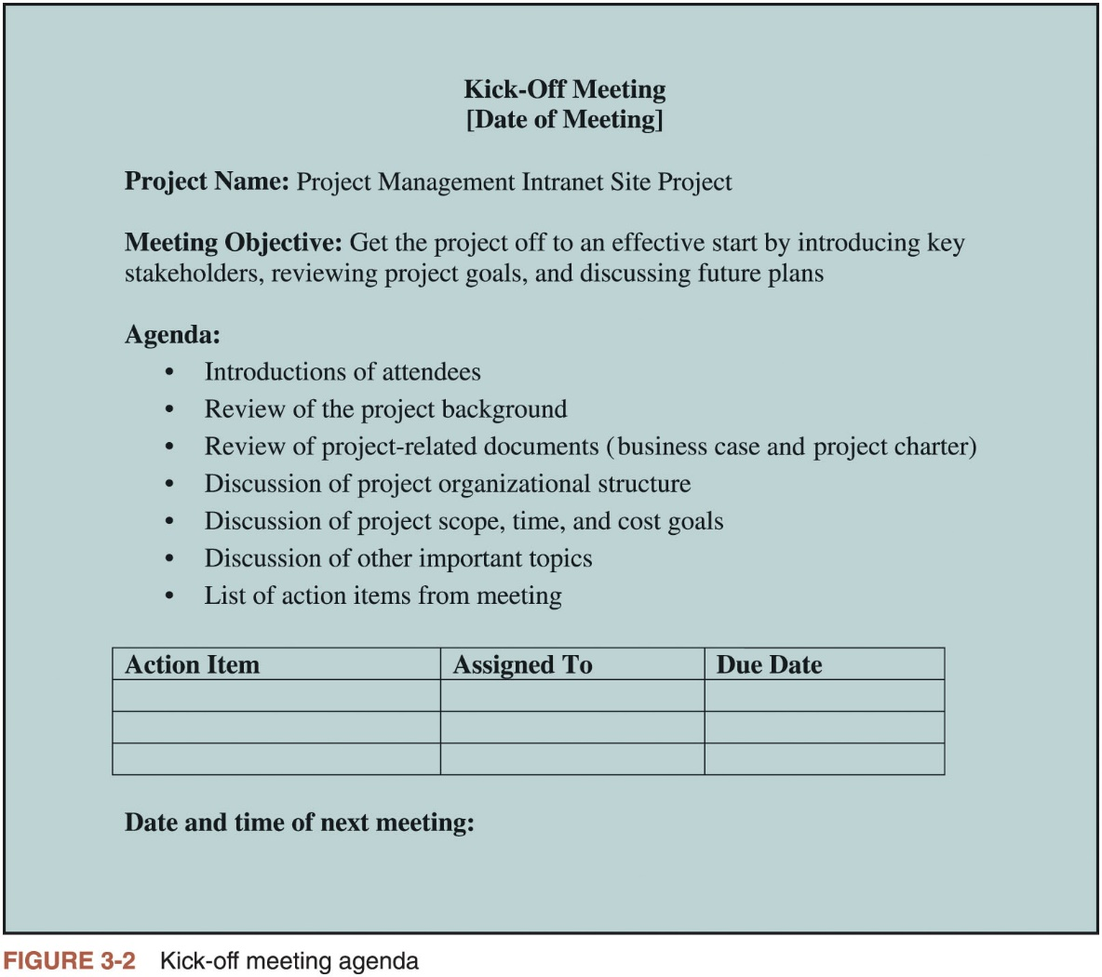
Initiating (5 of 5)

Slide 22
Planning processes

Slide 23
Project Planning
The main purpose of project planning is to guide execution
Every knowledge area includes planning information (see Table 3-7)
Key outputs included in the JWD project
Team contract
Project scope statement
Work breakdown structure (WBS)
Project schedule, in the form of a Gantt chart with all dependencies and resources entered
List of prioritized risks (part of a risk register)
See sample documents

Slide 24
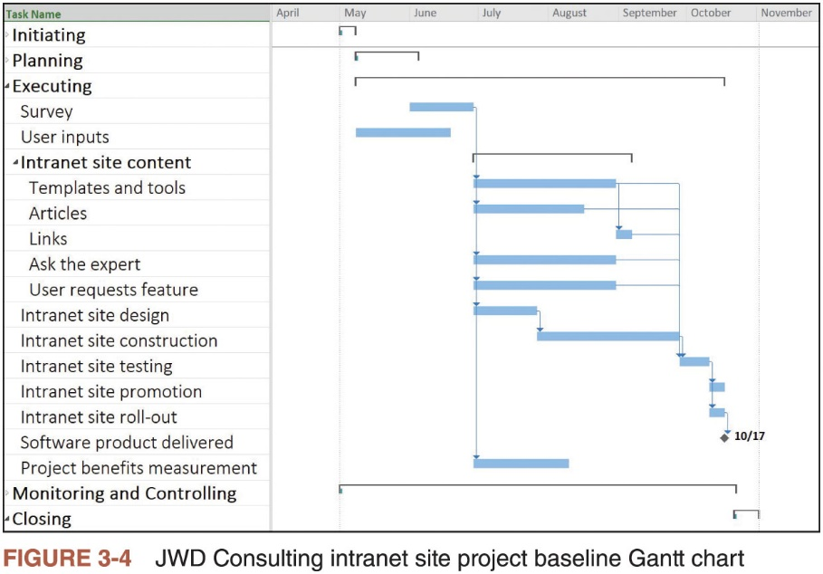
Project Planning

Slide 25
Project Planning
List of Prioritized Risks
Ranking | Potential Risk
1 | Lack of inputs from internal consultants
2 | Lack of inputs from client representatives
3 | Security of new system
4 | Outsourcing/purchasing for the article retrieval and Ask the Expert features
5 | Outsourcing/purchasing for processing online payment transactions
6 | Organizing the templates and examples in a useful fashion
7 | Providing an efficient search feature
8 | Getting good feedback from Michael Chen and other senior consultants
9 | Effectively promoting the new system
10 | Realizing the benefits of the new system within one year

Slide 26
Execution processes

Slide 27
Project Execution
Usually takes the most resources to perform
Project managers must use their leadership skills to handle the many challenges that occur during project execution
Listing the knowledge areas, executing processes, and outputs of project execution
Many project sponsors and customers focus on deliverables related to providing the products, services, or results desired from the project
It is equally important to document change requests and update planning documents
A milestone report can help focus on completing major milestones

Slide 28
Project Execution
The actions performed during this process include:
Performing the activities needed to meet the project objectives
Obtaining and manage quotations, bids and proposals as needed
Managing the project team and manage other resources
Collecting and analyze performance data
Generating project data for status reports and forecasts
Managing risks
Conducting change control and implementing approved changes
Establishing and managing project communication channels
Collecting and documenting lessons learned

Slide 29
Project Execution
The Execution Phase will broadly involve several actions.
The priority or sequence is entirely dependent on the nature of the project and organizational practices and preferences.
But nevertheless, they are performed to enable successful project execution.

Slide 30
Project Execution Actions
Acquire Develop & Manage the Team who will work on the project.
Execute Project Scope.
Recommend changes, bug fixes, preventive and corrective actions.
Timely Communication with all stakeholders.
Implemented approved changes to the processes, documentation and plans.
Team Building exercises.
Give recognition and rewards to team members and keep them motivated.
Hold Status Review meetings to ensure project is on track and any deviations are attended to at the earliest.
Use Work Authorization systems to allocate work.
Request Seller responses to your tender and outsourcing needs.
Select Seller for your procurement needs.

Slide 31
Project Execution
Project execution involves:
Establishing and managing the project team.
Coordinating people and resources.
Monitoring team performance.
Contracting procurements.
Directing and managing project execution.
Distributing information.
Performing quality assurance activities.

Slide 32
Project Execution
The items produced by project execution are:
The risk and issue management responses plus corrective actions.
The deliverables themselves plus work performance information.
Change requests.
Negotiation and influence to ensure appropriate staff are assigned.
Motivation building and mentoring to ensure the team performance.
Conflict resolution and problem solving.
Procurements and contracts are negotiated and put in place.
Organizational process assets are updated as a result of executing the project plan.

Slide 33
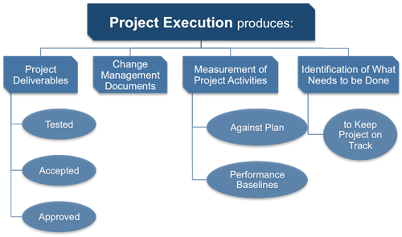
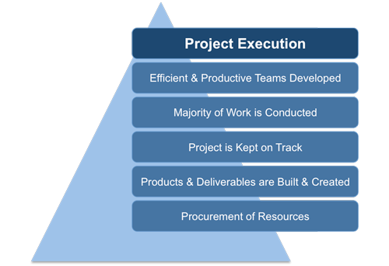
Project Execution

Slide 34
Best Practice
One way to learn about best practices in project management is by studying recipients of PMI’s Project of the Year award
The Quartier international de Montreal (QIM), Montreal’s international district, was a 66-acre urban revitalization project in the heart of downtown Montreal
This $90 million, five-year project turned a once unpopular area into a thriving section of the city with a booming real estate market and has generated $770 million in related construction

Slide 35
Monitoring and Controlling processes

Slide 36
Project Monitoring and Controlling
Project monitoring and control helps you measure project performance.
Use the process to look at the project plan, review project status, identify potential problems, and implement changes when necessary.
This phase coincides with the execution phase of the project lifecycle.
You can use this phase to keep a project on schedule and within budget while also managing risk and avoiding scope creep.
At the end of the monitoring and control phase, the customer accepts the completed project deliverables.

Slide 37
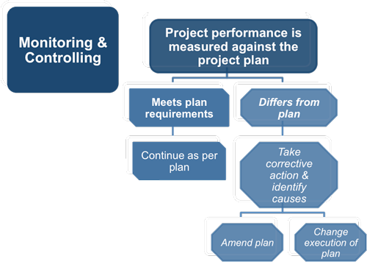
Project Monitoring and Controlling
Involves measuring progress toward project objectives, monitoring deviation from the plan, and taking correction actions
Affects all other process groups and occurs during all phases of the project life cycle
Outputs include performance reports, change requests, and updates to various plans

Slide 38
Project Monitoring and Controlling
The primary purpose of monitoring and control in project management is to identify problems before they occur and make adjustments.
These changes may require reevaluating and updating the project plan.

Slide 39
Project Monitoring and Controlling
Involves tracking, reviewing, and regulating project progress
Includes status reporting, progress measurement, and forecasting
Reports on scope, schedule, cost, resources, quality, and risks
Controls project and project document changes
Includes control of scope, schedule, costs, and risks
Formalizes acceptance of deliverables
Records quality control results
Implements risk treatment plans and actions
Administers suppliers

Slide 40
Project Monitoring and Control Process
The process helps project teams discover problems before they occur.
Monitor Key Performance Indicators (KPIs)
Monitor Change Requests
Monitor Project Scope
Identify Risks
Communicate with Team Members, Stakeholders, and Clients

Slide 41
Project Monitoring and Controlling
The key outputs are:
Progress and status reports
Plan updates
Risks registers
Change requests
Work products/deliverables

Slide 42
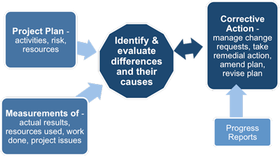
Project Monitoring and Controlling
Reporting mechanisms are time-sensitive.
Slow reporting mechanisms hinders controlling the project.
The control framework will vary from project to project, reflecting the size and complexity of the project and the extent to which the different levels of management are involved in it.

Slide 43
Closing processes

Slide 44
Project Closing
Involves gaining stakeholder and customer acceptance of the final products and services
Even if projects are not completed, they should be closed out to learn from the past
Outputs may include project files and lessons-learned reports
Also may include a final report and presentation

Slide 45
Project Closing
When it comes to project management, closing out a project isn’t just a matter of executing deliverables.
Though the process may seem tedious or overly administrative, a formal closure phase ensures all loose ends are tied up, documentation is signed and approved, contractors are paid, and everyone is on the same page.
The closing phase also gives you the opportunity to review and evaluate the project’s success (or failure), which is crucial for planning and executing successful projects in the future.

Slide 46
What is project closure?
The closing phase of project management is the stage where all deliverables are finalized and formally transferred, and all documentation is signed off, approved, and archived.
The project closure process ensures that:
All work has been completed according to the project plan and scope.
All project management processes have been executed.
You have received final sign-off and approval from all parties.
The project management closure process also gives the team the opportunity to review and evaluate the project’s performance to ensure future projects’ success.

Slide 47
Importance of closing a project
Project closure helps avoid:
Repeating mistakes on future projects and objectives
Having final products or deliverables without dedicated support and resources
Failing to identify the team or individuals who will own and maintain the solution following final delivery
Creating liability issues resulting from incomplete payments, contracts, or deliverables

Slide 48
7 steps to closing a project
The closing phase of project management involves several steps.
Work through the following checklist to ensure your project is successfully completed.
Formally transfer all deliverables
Finalize and transfer the project deliverables to the client.
Go through your project plan to identify all deliverables and make sure they have been fully completed and handed off.
Confirm project completion
It’s not enough to declare a project done yourself.
Each person involved needs to agree on the project’s completion before you can formally close it out and move on.
To confirm the project’s completion, obtain approvals for the project deliverables (i.e., all stakeholders must agree that you delivered on all parts of the project plan) with official sign-offs from the project stakeholders.

Slide 49
7 steps to closing a project
Review all contracts and documentation
Review all the project documentation to ensure all parties have been paid for the work and there are no outstanding invoices.
Release resources
Formally release resources from the project, including suppliers, contractors, team members, and any other partners.
Conduct a post-mortem
A post-mortem is one of the most valuable steps of the project closure process.
This is a time to review the successes, failures, and challenges of the project and identify opportunities for improvement going forward.

Slide 50
7 steps to closing a project
Archive documentation
Finalize all documentation (contracts, project plans, scope outline, costs, schedule, etc.) and index them in the company archives for later reference.
Celebrate
Finally, don’t forget to celebrate!
The end of a project is a big accomplishment and represents the culmination of many hours of hard work and dedication from a team of contributors.

Slide 51
Case Study 2: JWD Consulting’s Project Management Intranet Site (Agile Approach)
An agile project team typically uses several iterations or deliveries of software instead of waiting until the end of the project to provide one product
Teams do not normally make a snap decision about whether to manage a project using an agile approach or not

Slide 52
Agile and Scrum

Slide 53
Scrum Roles, Artifacts, and Ceremonies (1 of 5)
Product owner: person responsible for the business value of the project and for deciding what work to do and in what order, as documented in the product backlog
ScrumMaster: person who ensures that the team is productive, facilitates the daily Scrum, enables close cooperation across all roles and functions, and removes barriers that prevent the team from being effective
Scrum team or development team: cross-functional team of five to nine people who organize themselves and the work to produce the desired results for each sprint, which normally lasts two to four weeks

Slide 54
Scrum Roles, Artifacts, and Ceremonies (2 of 5)
An artifact is a useful object created by people
Scrum artifacts
Product backlog: list of features prioritized by business value
Sprint backlog: highest-priority items from the product backlog to be completed within a sprint
Burndown chart: shows the cumulative work remaining in a sprint on a day-by-day basis

Slide 55
Scrum Roles, Artifacts, and Ceremonies (3 of 5)
Scrum ceremonies
Sprint planning session: meeting with the team to select a set of work from the product backlog to deliver during a sprint
Daily Scrum: short meeting for the development team to share progress and challenges and plan work for the day
Sprint reviews: meeting in which the team demonstrates to the product owner what it has completed during the sprint
Sprint retrospectives: meeting in which the team looks for ways to improve the product and the process based on a review of the actual performance of the development team

Slide 56
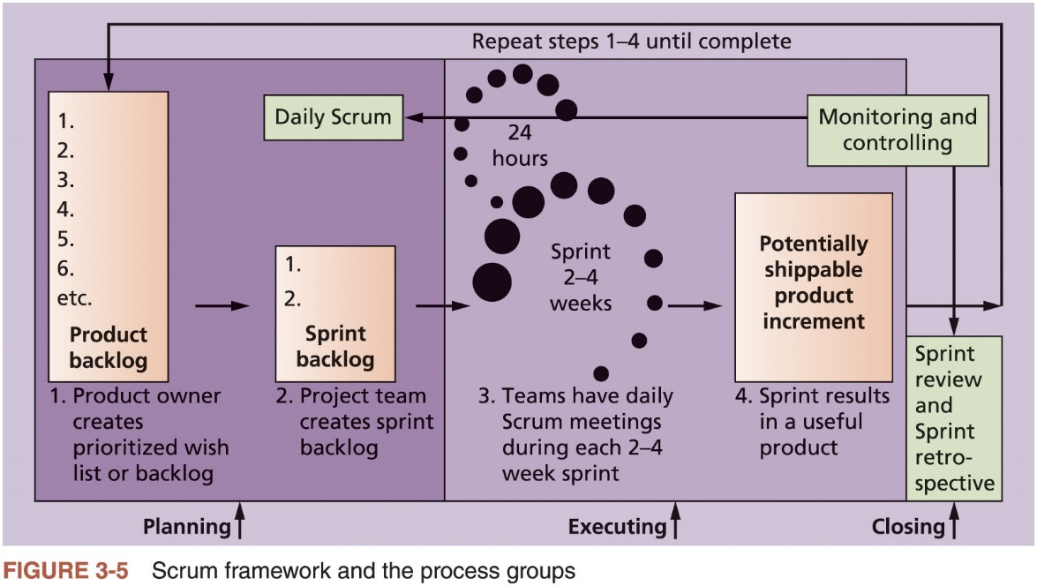
Scrum Roles, Artifacts, and Ceremonies (4 of 5)

Slide 57
Scrum Roles, Artifacts, and Ceremonies (5 of 5)
Process Group | Scrum Activity
Initiating
 | Determine roles
 | Decide how many sprints will compose each release and the scope of software to deliver
Planning
 | Create product backlog
 | Create sprint backlog
 | Create release backlog
 | Plan work each day in the daily Scrum
 | Document stumbling blocks in a list
Executing
 | Complete tasks each day during sprints
 | Produce a shippable product at the end of each sprint
Unique Scrum activities by process group

Slide 58
Project Pre-Initiation and Initiation
Main differences between pre-initiation in this case and the first case
Determining roles and deciding what functionality would be delivered as part of each release
How many sprints will be required to complete a release
How many releases of software to deliver

Slide 59
Planning (1 of 3)
Because Scrum implies that team members work as a self-directed group, coached by the ScrumMaster, a team charter should not be necessary
Descriptions of work are identified in the product and sprint backlogs
More detailed work is documented in technical stories
Team must estimate a velocity or capacity for each sprint

Slide 60
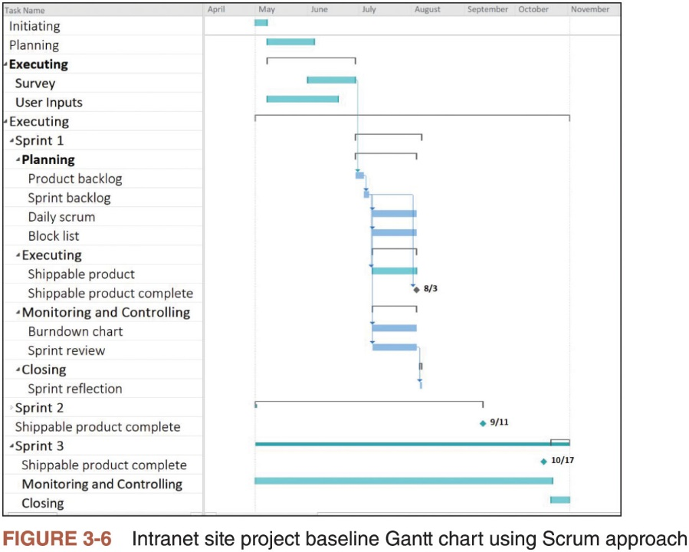
Planning (2 of 3)

Slide 61
Planning (3 of 3)
Product Backlog | Sprint Backlog
1. User story templates, samples, and point person | 1. User story templates, samples, and point person
2. WBS templates, samples, and point person | 2. WBS templates, samples, and point person
3. Project schedule templates, samples, and point person | 3. Project schedule templates, samples, and point person
4. Ability to charge customers for some intranet products and services | 4. Ability to charge customers for some intranet products and services
5. Ability to collect user suggestions | 5. Ability to collect user suggestions
6. Business case templates, samples, and point person
7. Ask the Expert feature
8. Stakeholder management strategy templates, samples, and point person
9. Risk register templates, samples, and point person
10. Etc.
Product and Sprint Backlogs

Slide 62
Executing
The most time and money should be spent on executing
Plans are implemented to create the desired product
Agile approach: team produces several iterations of a potentially shippable product
Users can access and make suggestions
Communications are different
Project team meets every morning, physically or virtually

Slide 63
Monitoring and Controlling (1 of 2)
The two main tools for monitoring and controlling in the Scrum framework
Daily Scrum: held each morning to plan and communicate work for the day and discuss any risks, issues, or blockers
Sprint review: work progress within a sprint can be represented on a sprint board maintained by the ScrumMaster
Burndown chart: an important artifact used to graphically display progress on each sprint

Slide 64
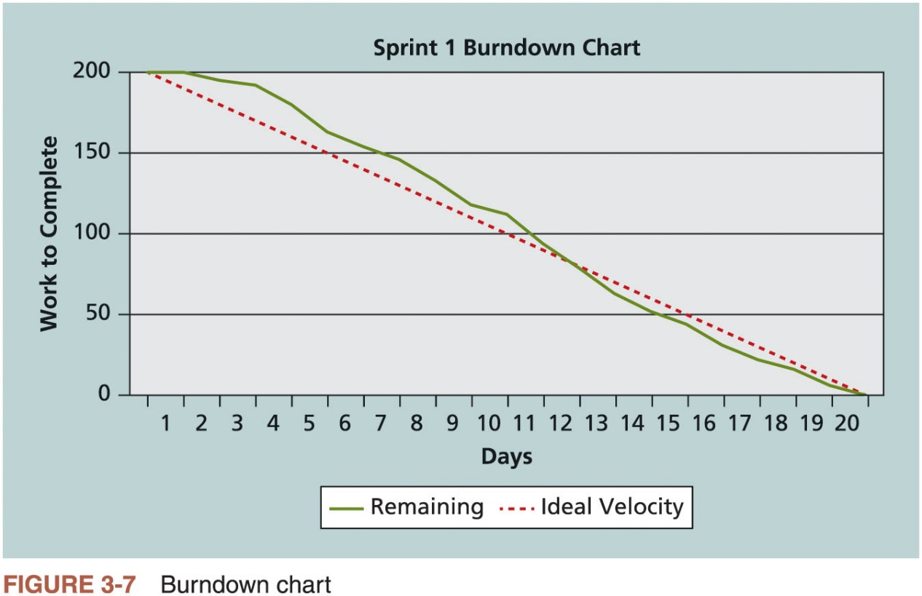
Monitoring and Controlling (2 of 2)

Slide 65
Closing
After the sprint review, the ScrumMaster leads a sprint retrospective
Team reflects on what happened during the sprint
Sprint retrospective is intended to answer two fundamental questions
What went well during the last sprint that we should continue doing?
What could we do differently to improve the product or process?

Slide 66
Templates by Process Group
Table 3-20 lists several templates used to prepare the documents shown in this chapter and later chapters
Download these and additional templates in one compressed file from the Companion website for this text or from the author’s website.

Slide 67
Advice for Young Professionals
Most organizations have templates for many different kinds of documents
Ask your boss, co-workers, and other colleagues for templates
If you don’t like the templates you find, look at other sources
If you can improve them, share your work with others
Templates are great, but completed templates with good information are even more useful

Slide 68
Chapter Summary
The five project management process groups are initiating, planning, executing, monitoring and controlling, and closing
You can map the main activities of each process group to the ten knowledge areas
Some organizations develop their own information technology project management methodologies
The JWD Consulting case study provides an example of using the process groups and shows several important project documents
The second version of the same case study illustrates how to use Scrum, the leading agile method, to manage the project

Slide 71
Initiating the Project

Slide 72
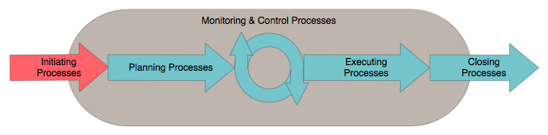
Initiating processes overview
Initiating processes deﬁne a new project or new phase of an existing project
Initial project scope, project stakeholders, and project manager are identiﬁed
Key purposes are to:
Align the stakeholders' expectations with project purpose
Give stakeholders visibility into project scope and objectives
Demonstrate that stakeholder participation helps ensure project success
All of these set the vision of the project: what needs to be accomplished

Slide 73
Initiating Processes
Develop Project Charter
This process falls under the Project Integration Management knowledge area
Justiﬁes and formally authorizes a project or a project phase
Documents the stakeholders’ initial requirements and expectations
Forms the basis for the partnership between the requesting (customer) and performing (supplier) organizations
Identify Stakeholders
This process falls under the Project Communications Management knowledge area
Identiﬁes all people or organizations impacted by the project
Documents their interests and involvement with the project, as well as their potential impact on project success
Forms the basis for developing a strategy to approach and involve each stakeholder to maximize positive inﬂuences and minimize negative inﬂuences

Slide 74
Concept Exploration
The “Why” phase
Not a “mandatory formal” phase
Sometimes called the “pre-project” phase
Collecting project ideas
Then the “funneling” process
Project Justification
ROI – Return on Investment
Cost-benefit analysis
Competitive analysis (if appropriate)
Initial planning and estimates

Slide 75
Concept Exploration
Possibly includes Procurement Management:
RFP Process
Vendor selection
Contract management
Gathering the initial team
Including PM if not already on-board
Identify the project sponsor
Primary contact for approval and decision making
Potential Phase Outputs:
Concept Document, Product Description, Proposal, SOW, Project Charter

Slide 76
Concept Exploration
Characteristics & Issues
Lack of full commitment and leadership
Some frustrations:
Management only getting rough estimates from development
Development not getting enough specifics from customer
Finding a balanced team
Budget sign-off may be your 1st major task
Achieved via:
Good concept document or equivalent
Demonstration of clear need (justification)
Initial estimates

Slide 77
Inputs, tools & techniques, and outputs
Inputs
Project statement of work
Business case
Agreements
Enterprise environmental factors
Organizational process assets
Tools & Techniques
Expert judgement
Facilitation techniques
Outputs
Project charter

Slide 78
Define the Project
There is a need for clear understanding of exactly what is to be done. Project definition starts with the Conditions of Satisfaction document based on conversation with the customer.
Project Overview Statement aka Charter or Vision is generated from the Conditions of Satisfaction document.
The Project Overview Statement clearly states what is to be done.
Once the Project Overview Statement is approved, the scoping phase is complete.
In most cases the Project Overview Statement, the Statement of Work, and Project Charter are the same. Even scope will fit here. We will use them interchangeably.

Slide 79
Project Charter
Activities
Define scope
Document Project Risks, Assumptions, and Constraints
Identify and Perform Stakeholder Analysis
Develop Project Charter
Obtain Project Charter Approval
Deliverables
Project charter
Statement of work (SOW) (aka Scope)
Notes:
PMP Chapter 2

Slide 80
Preliminary Scope
Project objectives
Product description
Deliverables
Constraints
Assumptions
Project acceptance criteria

Slide 81
Project Charter
The Conditions of Satisfaction statement provides the input we need to generate the Charter.
The Charter is a short document that concisely states what is to be done in the project, why it is to be done, and what business value it will provide to the organization when completed.
The main purpose of the Charter is to secure senior management approval and the resources needed to develop a detailed project plan.
It will be reviewed by the managers who are responsible for setting priorities and deciding what projects to support. It is also a general statement, it is not detailed technical statement.
A high-level project description:
Business need, product, assumptions
Often precedes SOW
Often 2-4 pages (can be longer)

Slide 82
Project Charter
Typical outline
Overview
Business need
Problem/opportunity
Objectives
Project goal
Method or approach
General scope of work
Success criteria
Rough schedule & budget
Roles & responsibilities
Assumptions, risks, obstacles

Slide 83
Project charter content
Project purpose or justiﬁcation
Deﬁne the reason why the project is being done, by referring to any of the Initiating process inputs [See the “vision statement”]
Measurable project objectives and related success criteria
Scope. Scope needed to achieve project goals and measurable criteria for scope success
Time. Goals for timely completion and speciﬁc dates for success
Cost. Goals for project expenditures and range of costs for success
Quality. Quality criteria and speciﬁc measures for criteria for success
Other. Any other objectives along with measurable criteria of success

Slide 84
Project charter content
High-level requirements
Describe the high-level product capabilities that satisfy stakeholder needs and expectations. Do not include detailed requirements
Example: As a retail customer, I want to shop by either brand or by product category
Example: As the site owner, I want a retail customer to ﬁnd a stocked product on the site within three (3) mouse clicks
Anti-example: As the site owner, I want the products to be displayed in a 4- across grid against a light grey background

Slide 85
Project charter content
Assumptions and constraints
An assumption is “a thing that is accepted as true or as certain to happen, without proof”
Example: The site will allow all site visitors to access all public features of the site
A constraint is a limitation or restriction
Example: The site must use a hosting service for the new site

Slide 86
Project charter content
High-level project description and boundaries [scope]
Provide an executive-summary-level description of the project, identify what will and will not be included in the project
Example: The site is a one-stop source for health and wellness information … It will not provide direct access to the HR site.
High-level risks
Risks represent any major areas of uncertainty for the project
Risks may be internal or external
Example: Existing customers may have difﬁculty transitioning to new site
Example: The company does not have sufﬁcient in-house Web design expertise to match the goals for the new site

Slide 87
Project charter content
Summary milestone schedule
Identify any signiﬁcant points or events in the project, such as key deliverables, beginning or ending of phases, or product acceptance
Include estimated completion dates for the milestones
Examples: Requirements document complete: 1/31/2017; Web site on-line with training: 6/30/2017
Summary budget
Provide a rough order of magnitude (ROM) estimate of expenditures schedule for project
ROM estimates may be as broad as ±100% but usually range ±35%
Budget should break down total expenditures by major categories (software, hardware, human resources, etc.)

Slide 88
Project charter content
Stakeholder list
A stakeholder is “a[n] individual, group, or organization who may affect, be affected by, or perceive itself to be affected by a decision, activity, or outcome of a project”*
Identify a preliminary list of the most critical project stakeholders–this list will be reﬁned later
Project approval requirements
Identify any criteria that must be met in order for the project to be accepted by the project customer
Example: The project must implement the set of ‘must-have’ user stories agreed upon at project initiation
Notes:
*PMBOK Guide, 5th Edition

Slide 89
Project charter content
Project manager, responsibility, and authority levels
Stafﬁng. Speciﬁc authority project manager is granted to hire/ﬁre, discipline, or accept/reject project staff
Budget management and variance. Speciﬁc authority project manager is granted to commit, manage, and control project funds; also, what variance requires higher approval
Technical decisions. Speciﬁc authority project manager is granted regarding deliverable technical decisions or project approach
Conﬂict resolution. Speciﬁc authority the project manager is granted to resolve team and organizational conﬂict, as well as conﬂict with external stakeholders
Escalation path for authority limitations. Deﬁne the path for escalation of issues exceeding the project manager’s authority
Name and authority of the sponsor or other person(s) authorizing the project charter
Notes:
*PMBOK Guide, 5th Edition

Slide 90
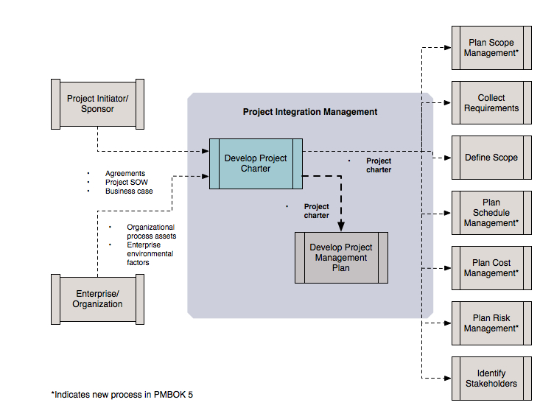
Develop Project Charter: Data Flow Diagram

Slide 91
Statement of Work (SOW)
A description of the work required for the project; normally this is used when the project is being contracted out, but most of this is part of the Project Overview or Charter
Sets the “boundary conditions”
SOW vs. CSOW (Contract SOW)
Latter: uses legal language as part of a competitive bidding scenario
Can be used in the final contract – be careful, be specific, be clear
Typically done after approval (after “Go”)
Can be multiple versions
List of deliverables for an RFP
More detailed within final RFP
Binding version from contract

Slide 92
SOW Template

Slide 93
S.M.A.R.T. characteristics for Goal
Doran’s S.M.A.R.T. characteristics provide the criteria for a goal statement:
Specific: Be specific in targeting and objective.
Measurable: Establish measurable indicator(s) of progress.
Assignable: Make the object assignable to one person for completion.
Realistic: State what can realistically be done with available resources.
Time-related: State when the objective can be achieved; that is, duration

Slide 94
The Project Definition Statement : PDS
Just as the customer and the project manager benefit from the Charter, the project manager and project team can benefit from a closely related document, which we call the Project Definition Statement (PDS).
The PDS uses the same form as the Charter but incorporates considerably more detail. The detailed information provided in the PDS is for the use of the project manager and the project team.

Slide 95
Charter
Tips on writing the charter
Distribution of project by type
In-house, contract/for-hire, startup
Distribution of project by technology
Web, Windows/Mac OS/Linux, Mobile, No platform
Distribution by industry
Financial Services, Law, Retail
A reminder why no two projects are same
Most important elements
Why, who, what, what not
A little bit of when
Make sure it's clear
Some more re-purposed than others
Occasionally read more like business plans

Slide 96
Charter
Make the stakeholder relationships clear
You, sponsor, user, etc.
If “for real” you’d want additional assumptions and scope constraint
The justification or cost-benefit analysis “materializes” in some of the Charters
Don’t shortchange downstream activities
Integration, testing, rollout, etc.
Risks
Business risks vs. Project risks
Ex: “lack of market adoption” vs. “inexperienced team”
Functionality
“Forgotten” items: user registration, help, security
Good out of scope items
Internationalization
Search system

Slide 97
Charter
Formalities
Spell check.
Proof read
Make sure your name is on first page and also header and/or footer on each page.

Slide 98
To Get to the Essence of a Project
Why is the system being developed?
What will be done?
When will it be accomplished?
Who is responsible?
Where are they organizationally located?
How will the job be done technically and managerially?
How much of each resource (e.g., people, software, tools, database) will be needed?
Barry Boehm

Slide 99
The project charter & agile
The project charter sets out the earliest deﬁnition for the project
Note: PMI has eliminated an earlier (v. 3) Deﬁne Preliminary Scope Statement from among the PMBOK processes, which further deﬁned and constrained the project
The agile product overview document provides a high-level view of the most essential project elements that parallels the charter
The product overview is less detailed and more flexible

Slide 100
Product overview document content
Product Name
Product Vision Statement. Include both product problem statement and product position statement
Dedicated Team. List names of team members
Project Manager
Customer/Product Owner. Customer or customer representative
Architecture. Specify if constrained; else, to be determined by team
Features Backlog. High-level list of major features
Product Roadmap. Releases with themes and corresponding features
Risks/Opportunities. Consider market, project, and product aspects
Success Criteria. What the customer considers most critical criteria
Flexibility Matrix. Trade-off matrix of time, resources, and objectives

Slide 101
Agile initiating process
Obtain input and feedback from customer and team on project objectives and justiﬁcations as part of vision meeting
If needed, prepare ‘barely sufﬁcient’ business case and associated documentation required by the company and/or project approval board in order to obtain project approval
Use an agile software development methodology and prepare accordingly

Slide 102
Stakeholders

Slide 103
Project stakeholders
Project stakeholders are individuals or organizations who have inﬂuence over, or are inﬂuenced by project execution or completion
Different stakeholders have varying amounts of inﬂuence, responsibility, or authority over a project
Stakeholders can have a positive, neutral, or negative inﬂuence on a project
Identifying all stakeholders associated with a project may be difﬁcult
Stakeholders that are overlooked almost inevitably have a negative impact on project

Slide 104
Interactions / Stakeholders
As a PM, who do you interact with? Project Stakeholders
External people
Project sponsor
Executives
Customers
Contractors
Functional managers
Users
Team
Architects
System Engineers
Designers
Developers
Testers
Documenters
Notes:
Project stakeholders are individuals or organizations who have influence over, or are influenced by project execution or completion
Have varying amounts of influence, responsibility, or authority over project
May be difficult to identify all stakeholders
Stakeholders that are overlooked almost inevitably have a negative impact on project
Stakeholders can have a positive, neutral, or negative influence on project
managing all stakeholder expectations is challenging – conflict

Slide 105
Key project stakeholder roles
Customer. Person or organization that acquires product
User. Person or organization that uses product
Performing organization. Organization performing work of project
Project manager. Responsible for managing project
Project management team. Individuals directly involved in project management activities
Project team members. Individuals performing work of project
Sponsor. Entity providing financial resources for project
Influencers. Entities indirectly affecting project
PMO. Project management office. Responsible for centralized and coordinated management of all projects under its supervision

Slide 106
Signiﬁcant project stakeholders
Functional managers. Manage within functional or administrative areas of the business, such as human resources, accounting, or procurement. Do not deal directly with products or services
Operations management. Manage within core business areas, such as research and development, design, manufacturing, testing, or maintenance. Deal directly with producing and maintaining products
Sellers. External companies or individuals that enter into contractual agreements to provide components or services necessary for project. Also known as vendors, suppliers, or contractors
Business partners. External companies or individuals that have a closer relationship with enterprise, providing expertise or ﬁlling speciﬁc roles such as installation, training, or support

Slide 107
Stakeholders
Senior managers who define the business issues that often have significant influence on the project.
Project (technical) managers who must plan, motivate, organize, and control the practitioners who do software work.
Practitioners who deliver the technical skills that are necessary to engineer a product or application.
Customers who specify the requirements for the software to be engineered and other stakeholders who have a peripheral interest in the outcome.
End-users who interact with the software once it is released for production use.

Slide 108
Software System Stakeholders
Each stakeholder has different concerns:
Customer
Manager
Architect
Developer
Tester
Requirements
Cost
Schedule
Performance
Reliability
Security
Cost
Schedule
Requirements
Process
Resources
Maintainability
Portability
Feasibility
Reusability
Extensibility
Flexibility
The ilities
Components
Connectors
Class/Pattern
Data flow
Reuse
Flexibility
Extensibility
Functionality
Requirements
Regression
Tools
Simulators

Slide 109
Stakeholder Triad
Function Representative
The ‘business person’, Business Analyst (BA)
Or SME: Subject Matter Expert
Executive Sponsor
Project's visionary & champion
Also the ‘General’, ‘Fall Guy’, and ‘Minesweeper’
Not the PM, ’Santa Claus’, or the ‘Tech Guy’
Project Manager
The ‘Linchpin’
Must be ‘multi-lingual’

Slide 110
Understanding Organizations
Structural frame: Focuses on roles and responsibilities, coordination and control. Organization charts help define this frame.
Human resources frame: Focuses on providing harmony between needs of the organization and needs of people.
Political frame: Assumes organizations are coalitions composed of varied individuals and interest groups. Conflict and power are key issues.
Symbolic frame: Focuses on symbols and meanings related to events. Culture is important.

Slide 111
Organizational Structures
Functional
Engineering, Marketing, Design, etc.
P&L from production
Projectized
Project A, Project B
Income from projects
PM has P&L responsibility
Matrix
Functional and Project based
Program Mgmt. Model
Shorter cycles, need for rapid development process

Slide 112
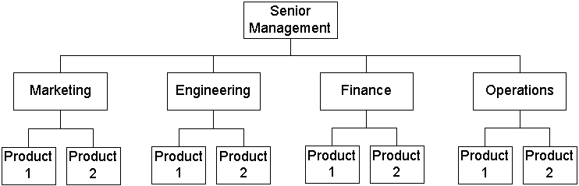
Functional Organization
Pros
Clear definition of authority
Eliminates duplication
Encourages specialization
Clear career paths
Cons
“Walls”: can lack customer orientation
“Silos” create longer decisions cycles
Conflicts across functional areas
Project leaders have little power

Slide 113
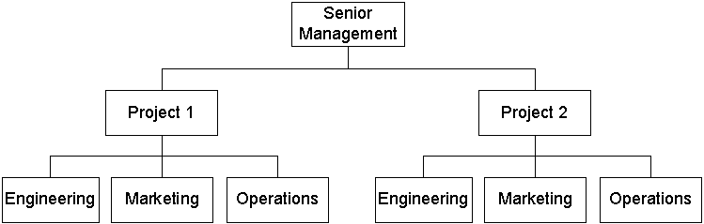
Projectized Organization
Pros
Unity of command
Effective intra-project communication
Cons
Duplication of facilities
Career path
Examples: defense avionics, construction

Slide 114
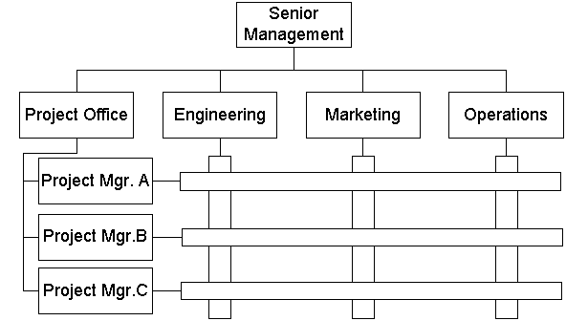
Matrix Organization
Pros
Project integration across functional lines
Efficient use of resources
Retains functional teams
Cons
Two bosses for personnel
Complexity
Resource & priority conflicts

Slide 115
Matrix Forms
Weak, Strong, Balanced
Degree of relative power
Weak: functional-centric
Strong: project-centric

Slide 116
Organizational Structure – Influences on Projects
PMBOK Guide, 2000, p. 19

Slide 117
Common-Sense Approach to Projects
Start on the right foot. This is accomplished by working hard (very hard) to understand the problem that is to be solved and then setting realistic objectives and expectations.
Maintain momentum. The project manager must provide incentives to keep turnover of personnel to an absolute minimum, the team should emphasize quality in every task it performs, and senior management should do everything possible to stay out of the team’s way.
Track progress. For a software project, progress is tracked as work products (e.g., models, source code, sets of test cases) are produced and approved (using formal technical reviews) as part of a quality assurance activity.
Make smart decisions. In essence, the decisions of the project manager and the software team should be to “keep it simple.”
Conduct a postmortem analysis. Establish a consistent mechanism for extracting lessons learned for each project.

Slide 118
Project Planning

Slide 119

Project Planning
“Now the general who wins a battle makes many calculations in his temple ere the battle is fought. The general who loses a battle makes but few calculations beforehand. Thus do many calculations lead to victory, and few calculations to defeat”
Sun Tzu, The Art of War

Slide 120
Software Project Planning
The overall goal of project planning is to establish a pragmatic strategy for controlling, tracking, and monitoring a complex technical project.
Or,
A Plan is the strategy for the successful completion of the project. It's a description of the project steps that produce increasing maturity of the products or processes produced by the project.
Why?
So the end result gets done on time, with quality!

Slide 121
Planning
“You've got to be very careful if you don't know where you're going, because you might not get there.”
“If you don't know where you are going, you will wind up somewhere else.”
“If you don't know where you're going, any road will take you there.”
“If you don’t know where you’re going, how do you know when you get there?”
– Yogi Berra
“The nicest thing about not planning is that failure comes as a complete surprise and is not preceded by a period of worry and depression.”
– John Preston, Boston College

Slide 122
Why plan?
Why plan?
Consider driving a car: do you drive looking backwards?
Recall from the Standish Group's 2009 CHAOS Report:
‘Proper Planning’ was the 4th ranked factor cited for successful projects (just behind ‘Clear Statement of Requirements’)
‘Lack of Planning’ was the 7th ranked factor cited for failed projects (just behind ‘Changing Requirements’)
We will soon see that the close correlation of requirements and planning is no coincidence: establishing requirements is an essential part of planning

Slide 123
Reasons people don’t plan
Don’t believe in planning
Management or organization culture does not support planning
Find the process painful
If you do plan, the pain will be greatest early and will diminish with time
If you don’t plan, you defer the pain (and it will usually be greater…)
Don’t have time to plan!
Consider the simple task of getting yourself to class
Now consider having the responsibility of getting all the other people to class on time, not just SE 477 but other classes, as well …

Slide 124
Planning is essential to control
An effective way to exert control is to:
Know where you are
Know where you are supposed to be
Take corrective action if there is a difference between the two
Note:
You have to have a plan to know where you are supposed to be
If you have no plan, you have no control
Example: Commercial airliner ﬂying from Chicago to Tokyo
Planning and control
Two phases both needed

Slide 125
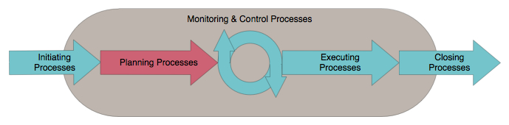
Planning processes
Planning processes determine the total project scope, deﬁne or reﬁne the project objectives, and develop the course of action to achieve the objectives
Planning employs progressive elaboration: the process of revisiting planning (and possibly initiating) processes as additional project information becomes available
The planning processes covered in SE 477 encompass project integration management, project scope management, project time management, project risk management, and project stakeholder management
Notes:
Adapted from Figure 2-10 PMBOK Guide, 5th Edition

Slide 126
Planning
Preliminary planning starts on day one
Even in the pre-project phase
Should not be conducted “in secret”
Need buy-in and approval
Very important step
Both from above and below

Slide 127
Planning
Scoping
What is the problem
How much will it cost?
Estimation
How long will it take?
Schedule
Resources
How many people will it take?
Risk
What might go wrong?
Control Strategy

Slide 128
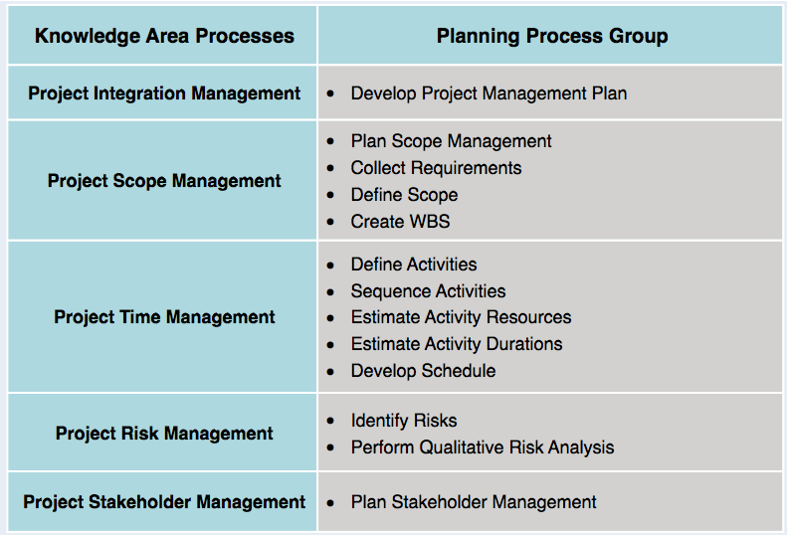
Planning processes and knowledge areas

Slide 129
Primary Planning Steps
Identify project scope and objectives
Define and Record Requirements
Identify project organizational environment
Analyze project characteristics
Identify Project Team and Define Roles and Responsibilities
Identify project products and activities
Create the WBS
Estimate effort for each activity
Allocate resources
Schedule deliveries and milestones

Slide 130
Primary Planning Steps
Develop Change Management Plan
Identify Risks and Define Risk Strategies
Review and communicate plan
Obtain Plan Approval
Conduct Kick-off Meeting

Slide 131
Project Planning Task Set – I
Establish project scope
Determine feasibility
Define required resources
Determine required human resources
Define reusable software resources
Identify environmental resources
Estimate cost and effort
Decompose the problem
Develop two or more estimates using size, function points, process tasks or use-cases
Reconcile the estimates

Slide 132
Project Planning Task Set – II
Develop a project schedule
Scheduling is considered in detail later.
Establish a meaningful task set
Define a task network
Use scheduling tools to develop a timeline chart
Define schedule tracking mechanisms
Analyze risks
Risk analysis is considered in detail later.

Slide 133
Software Project Survival Guide
Documents
Plans, reports
Schedules
Checklists

Slide 134
Process Issues
You want a fairly sophisticated process without incurring much overhead
Remember, projects are often larger than they first appear
Easier to loosen too much process than add later

Slide 135
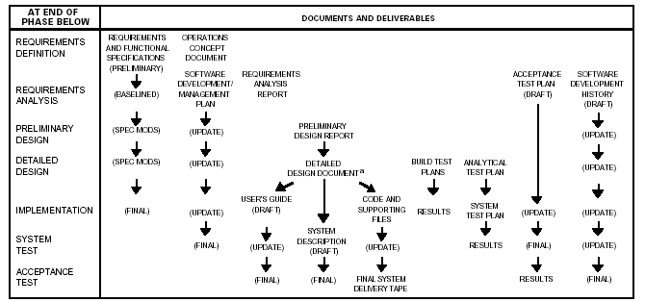
Plans Evolve Over Time
NASA's “Manager's Handbook for Software Development”

Slide 136
Software Development Plan (SDP)
Software Project Management Plan (SPMP)
Some consider it the most important document in the project (along with requirements document)
Can be seen as an aggregation of other core documents
Evolves over time as pieces come together

Slide 137
SDP / SPMP
Fundamental Sections
Project overview
Deliverables
Project organization
Managerial processes
Communication management plan
Milestones
Technical processes
Budget
Schedule

Slide 138
Preliminary Scope
Project objectives
Product description
Product objectives
Product deliverables
Requirements (product and project)
Exclusions (project boundary)
Constraints
Assumptions
High-level risks and definitions
Milestones
Initial WBS
Cost Estimate
Configuration management requirements
Project acceptance criteria
Notes:
PMP Guide – p. 75

Slide 139
Deliverables
List of items to be delivered
Must be tangible items
Sample deliverables
The product – the actual software, in the installable format
Product documentation
Reports and planning documentation
Most projects are driven by deliverables, so you need several
Project deliverables (aka documents) are included

Slide 140
Communications Management Plan
Often a section of Software Project Management Plan (SPMP)
Describes information flow to all parties
Gathering and distributing information
Status meetings
Monthly, Weekly, Daily?
Status reports are vital
Stakeholder Management Plan

Slide 141
Documents
Two kinds of documents
Planning
Product
Let us review each kind …

Slide 142
Planning Documents
Project ROI Analysis
Business Case (include competitive analysis if appropriate)
Project Charter
Statement of Work (SOW)
Software Project Management Plan (SPMP)
Software Development Plan (SDP)
Schedule
Communications Management Plan
Budget
Responsibility Assignment Matrix (RAM)
Risk Management Plan

Slide 143
Planning Documents
Other documents you may want/need
Software Quality Assurance Plan (SQAP)
Software Process Improvement Plan
Software Configuration Management Plan (SCMP)
Migration Plan
Operations Plan

Slide 144
Planning Documents
You (the PM) need to choose which documents are appropriate
Docs do not have to be lengthy
Small Set:
Software Development Plan
Risk Management Plan
Software Quality Assurance Plan
Software Configuration Management Plan

Slide 145
Product Documents
Statement of Need
System Interface Specification
Software Requirements Specification
Software Design Specification
Software Validation & Verification Plan
User Documentation
Support Plan
Maintenance Documentation

Slide 146
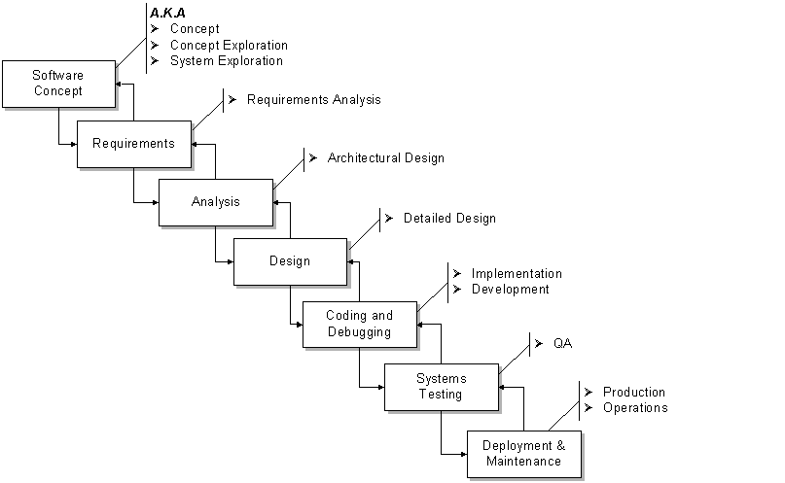
Project Phases

Slide 147
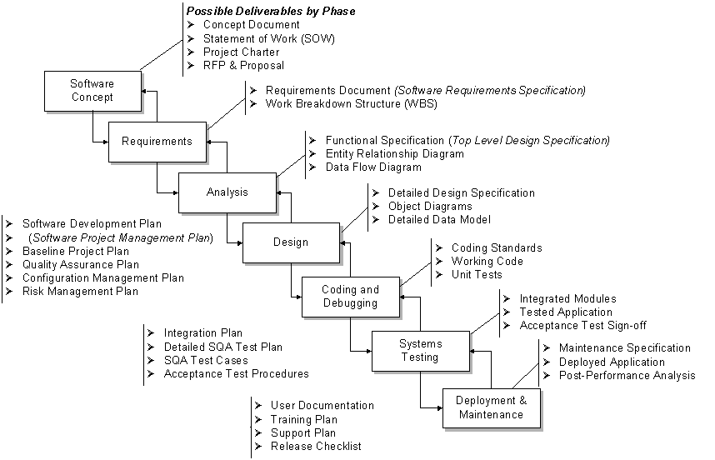
Potential Deliverables by Phase

Slide 148
Time Allocation by Phase
Remember the 40-20-40 Rule
Specification-Implementation-Test
 | Planning | Code & Unit Test | Integration & Test
Commercial DP | 25% | 40% | 35%
Internet Systems | 55% | 15% | 30%
Real-time Systems | 35% | 25% | 40%
Defense Systems | 40% | 20% | 40%
Bennatan, E.M, “On Time Within Budget”
Notes:
The 40-20-40 rule emphasizes strong front-end design (40%) and back-end testing (40%), whereas the mechanical programming (coding) task is de-emphasized (20%).

Slide 149
Time Allocation by Phase
Activity | Small Project (2.5K LOC) | Large Project (500K LOC)
Analysis | 10% | 30%
Design | 20% | 20%
Code | 25% | 10%
Unit Test | 20% | 5%
Integration | 15% | 20%
System test | 10% | 15%
McConnell, Steve, “Rapid Development”

Slide 150
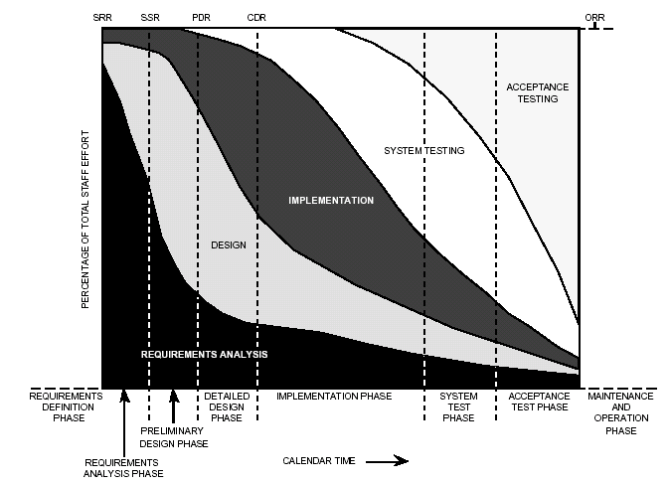
Activities by % of Total Effort
NASA's “Manager's Handbook for Software Development”

Slide 151
Conventional planning approach
Planning seems to be a straightforward process:
Determine the tasks to be done
Determine the order of the tasks
Execute the tasks in the proper order
Uncertainty can, and usually does, disrupt this ﬂow
Not every task can be identiﬁed before the project starts
Contingent factors—internal or external—add, delete, or modify tasks
Task ordering is changed due to new or unforeseen dependencies
At their very foundations, conventional planning approaches implicitly assume an unrealistic model of human cognition and behavior, while ignoring or underestimating real-world risk

Slide 152
Planning in an IID methodology
In contrast to big, up-front planning or even planning in conventional iterative and incremental methodologies, an IID methodology spreads planning out over the entire project lifecycle
Planning in an IID methodology:
Distributes planning from the top-level stakeholders to the individual developers—each plans at the appropriate scale
Delays ﬁne-grained planning to ‘just-in-time’ before corresponding task or activity
Is low-overhead—‘barely sufﬁcient’ planning documents are lightweight and the majority are produced ‘as-needed’ rather than as a matter of protocol
Is resilient to requirements changes—it embraces change rather than attempts to prevent or avoid it

Slide 153
Planning In The Iterative Development Model
Needs to take into consideration the iterations
See slides 45-51, 92-96 of lecture 2
See PMBOK-SWE Ch. 2.4.2.3
See also: Kruchten, P (2002, Oct 15) Planning an Iterative Project: http://www.ibm.com/developerworks/rational/library/2831.html

